Slide 1

The Engagement Insight Engine
An intelligent, AI-driven microservice designed to deeply understand and improve user engagement on online learning and professional growth platforms.

Slide 2

Addressing the Engagement Gap
In modern upskilling ecosystems, users often start strong but gradually lose momentum, missing chances to showcase their skills, build networks, and reach their goals. The Engagement Insight Engine tackles this by analyzing user profiles and activities, comparing them to peers, and delivering smart, personalized nudges to keep them active and visible.
By combining deterministic rules with machine learning, the system motivates users to complete profiles, upload resumes, attend events, and engage in projects — helping them stand out and grow their presence effectively.
Personalized nudges: Tailored recommendations to keep users active and visible.
Goal Achievement:
Helps users complete profiles, upload resumes, and engage in activities.
Hybrid Logic:
Combines rule ML-driven &
Rule based decision-making
for optimal guidance.

Slide 3
System Overview: From Data to Nudges The engagement insight engine acts as an intelligent microservice that converts raw user data into personalized, impactful recommendations, keeping users engaged and moving forward. It uses a structured, step-by-step process from data ingestion to final nudges — to ensure every suggestion is relevant and actionable.
Data Ingestion
User profile, activity metrics, and peer snapshots sent via FastAPI JSON payload.
Rule-Based Engine
Deterministic rules (from config.json) apply explicit conditions for high-priority nudges.
Machine Learning Engine
Pre-trained logistic regression models predict additional opportunities for improvement.
Nudge Compilation
Prioritized nudges (up to 3) with clear titles, messages, and priority labels are compiled.
Real-time Response & Logging
Response returned to client, and all major steps are logged for
transparency and debugging.

Slide 4
Methodology: Hybrid Logic for Personalized Guidance. The engagement insight engine uses a hybrid approach combining rule-based logic and machine learning to deliver personalized nudges. Powered by fastapi and pydantic, it ensures robust, clear, and seamless data handling throughout.
Workflow:
User fills JSON input in Swagger UI → validated by Pydantic models.
Data passed to hybrid-based logic → high-priority deterministic nudges generated.
Nudges structured and prioritized → returned as JSON response.
Logs recorded → transparent and debuggable.

Slide 5
Implementation: Modular, Scalable, and Offline-Ready The system was built as a fastapi microservice for its simplicity, speed, and built-in interactive API docs (swagger UI)
API development:
RESTful endpoints use strict Pydantic validation with example schemas in Swagger UI for easy testing, and all API requests are logged for monitoring and debugging.
Containerization & deployment:
A custom Dockerfile enables platform-independent, lightweight, and seamless deployment on local or cloud environments.
Technology Stack
Backend: FastAPI, Uvicorn
ML & Scoring: scikit-learn, joblib
Data Validation: Pydantic
Containerization: Docker
Logging: Python's standard logging module.

Slide 6
Technologies used: The engine was built using modern, carefully selected tools to ensure clarity, maintainability, high performance, and smooth offline-ready deployment.
Python 3.9+
Primary language for backend, data simulation, feature engineering, and ML integration.
FastAPI & Uvicorn
High-performance framework for RESTful API development and efficient application serving.
Pydantic
Robust data validation and parsing for strict type checking and clear schemas.
scikit-learn & joblib
Core libraries for ML model training (logistic regression) and serialization for faster deployment.
Docker
Containerization for consistent, reproducible environments across deployments.
Swagger UI
Interactive interface for live API testing and validation of payloads.

Slide 7
File structure :
FprojectCode/
├── main.py
├── models.py
├── config.json
├── event_fomo_score.py
├── generate_training_dataset.py
├── processed_fomo_dataset.csv
├── simulate_data.py
├── simulated_profile.json, peer_snapshot.json
├── train_model.py
├── models/
│ └── model_resume.pkl
│ └── model_event.pkl
├── reports/
│ └── *.csv, *.png
├── requirements.txt
├── Dockerfile
└── README.md

Slide 8
Key files:
Main.Py: Entry point for FastAPI, managing endpoints, logging, and nudge logic.
Models.Py: Defines Pydantic models for strict request and response validation.
Config.Json: Central config for rules, thresholds, and priorities.
Event_fomo_score.Py: Functions to compute FOMO scores and analyze engagement gaps.
Generate_training_dataset.Py: Converts simulated data into ML-ready datasets.
Simulate_data.Py: Generates offline synthetic user and peer data.
Train_model.Py: Trains ML models and generates evaluation reports.
Folders & other files
Models/: Stores serialized ML model files
.
Reports/: contains classification metrics, feature importance, and visualization plots.
Requirements.Txt: lists all python dependencies for consistent package installation.
Dockerfile: defines instructions for building the container image for deployment.
Readme.Md: main documentation, setup, API usage, and deployment guide.

Slide 9
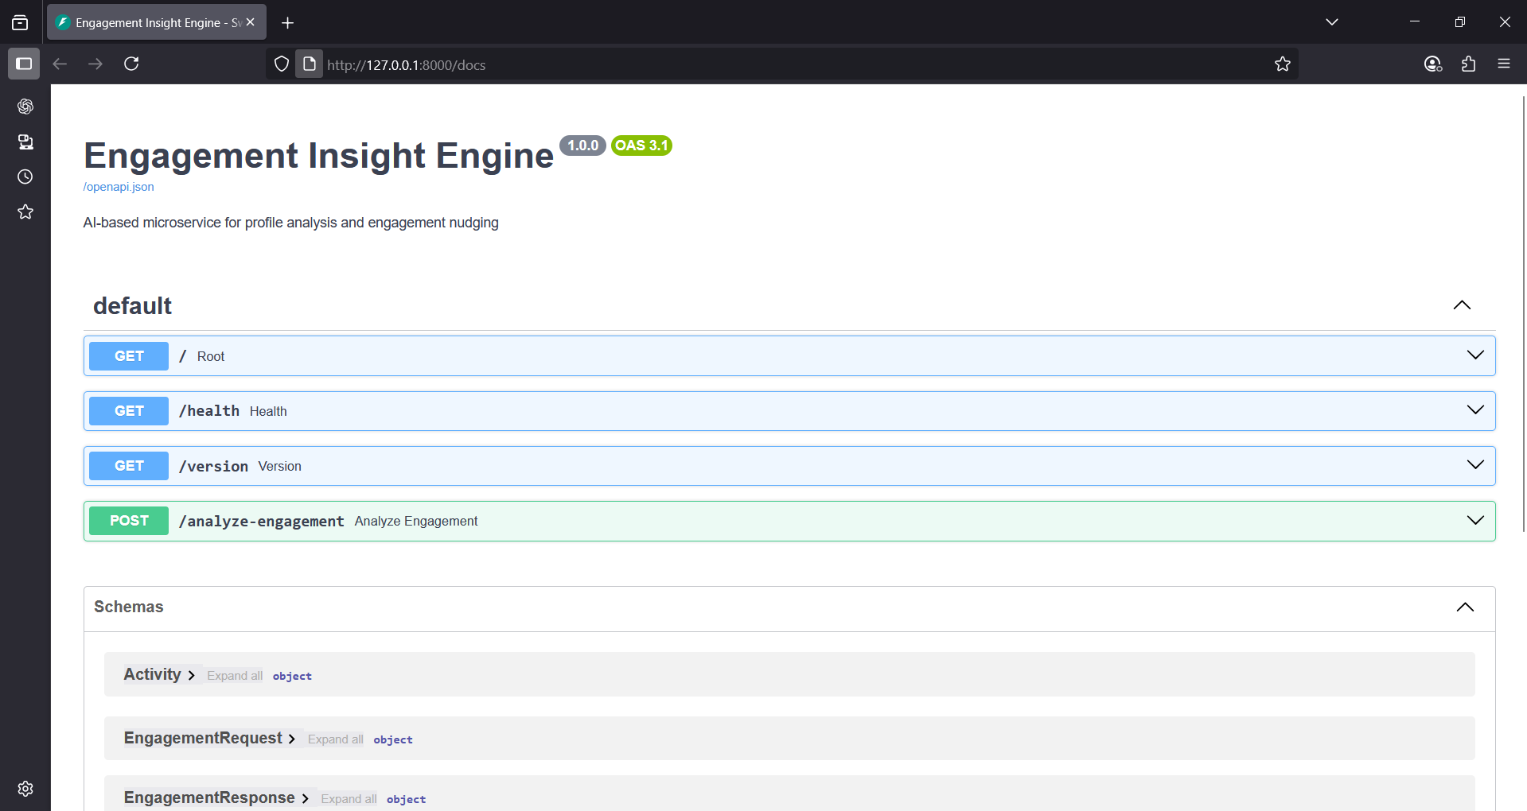
Fastapi interface:

Slide 10

Conclusion:
The Engagement Insight Engine successfully provides personalized, data-driven engagement strategies. Its hybrid logic, modular design, and offline/containerized architecture ensure privacy, independence, and scalability.
Reliable & Adaptable:
Combines rules and ML for timely, relevant nudges.
Seamless Integration
FastAPI, Pydantic, and robust logging simplify deployment.
Enhanced Engagement
Fosters active, supportive learning communities.

Slide 11
THANKYOU
PROJECT LINK: https://github.com/yuvarajmadugu/Engagement_insight_engine
SUBMITTED BY:
YUVARAJ MADUGU.
Software Engineer Intern @turtil,
3rd year graduate @kprit CSE – AIML.
Linkedin: https://www.linkedin.com/in/yuvarajmadugu/
Portfolio: https://yuvarajmadugu.github.io/Portfolio/

